Slide 1


Object Oriented Analysis and Design with Java
UE20CS352
Prof. Nivedita Kasturi
Department of Computer Science and Engineering

Slide 2


UE20CS352: Object Oriented Analysis and Design with Java
OO Design Patterns
Prof. Nivedita Kasturi
Department of Computer Science and Engineering

Slide 3
UE20CS352: Object Oriented Analysis and Design with Java
Unit-4
Creational Patterns – Singleton

Slide 4
Agenda
Introduction to creational design patterns
Types of creational Design Patterns.
Singleton-definition
Motivation
Intent
Problem(use case)
Solution (without singleton and with singleton)
Implementation
Applicability
Consequence

Slide 5
Introduction to Creational Design Pattern
Creational design patterns provide various object creation mechanisms, which increase flexibility and reuse of existing code.
The basic form of object creation could result in design problems or added complexity to the design.
Creational design patterns solve this problem by somehow controlling this object creation.
Recurring themes:
Encapsulate knowledge about which concrete classes the system uses (so we can change them easily later)
Hide how instances of these classes are created and put together (so we can change it easily later)

Slide 6
Introduction to Creational Design Pattern
Everyone knows an object is created by using new keyword in java.
For example:
StudentRecord s1=new StudentRecord();
The new operator is often considered harmful as it scatters objects all over the application. Over time it can become challenging to change an implementation because classes become tightly coupled.
Hard-Coded code is not a good programming approach. Here, we are creating the instance by using the new keyword. Sometimes, the nature of the object must be changed according to the nature of the program. In such cases, we must get the help of creational design patterns to provide more general and flexible approach.
Notes:
Creational Design Patterns address this issue by decoupling the client entirely from the actual initialization process.

Slide 7

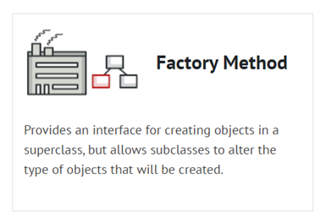
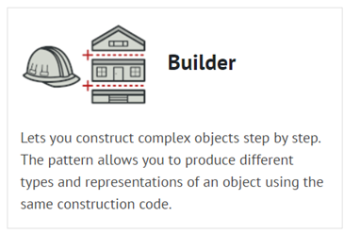
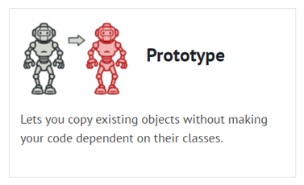
Types of Creational Design pattern
Composition over inheritance: "Favor 'object composition' over 'class inheritance'." (Gang of Four 1995:20)

Slide 8
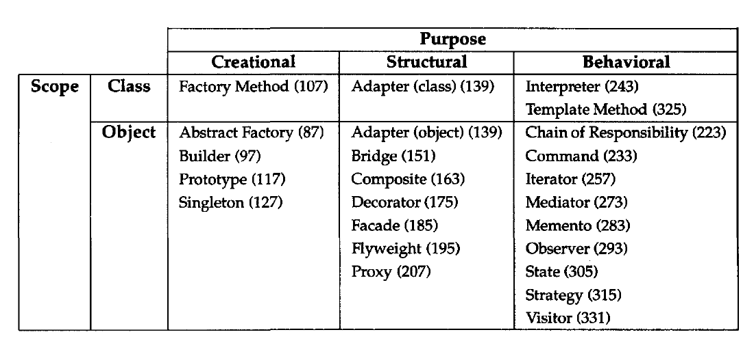
Types of Creational Design pattern: Scope

Slide 9
Singleton: Class, Object Structural
Motivation
The Singleton is part of the Creational Design Pattern Family .Singleton Design Pattern aims to keep a check on initialization of objects of a particular class by ensuring that only one instance of the object exists throughout the Java Virtual Machine.
A Singleton class also provides one unique global access point to the object so that each subsequent call to the access point returns only that particular object.
A real-life example will be, Imagine you work for a big company that has cloud storage💾 system for storing shared resources of files, images and documents we create shared storage as creating separate cloud storage💾 for every user👩‍💻 may be costly.
Definition: The singleton pattern is a design pattern that restricts the instantiation of a class to one object.
Notes:
It's important for some classes to have exactly one instance. Although there can be many printers in a system, there should be only one printer spooler. There should be only one file system and one window manager. A digital filter will have one A/D converter. An accounting system will be dedicated to serving one company. How do we ensure that a class has only one instance and that the instance is easily accessible? A global variable makes an object accessible, but it doesn't keep you from instantiating multiple objects. A better solution is to make the class itself responsible for keeping track of its sole instance. The class can ensure that no other instance can be created (by intercepting requests to create new objects), and it can provide a way to access the instance. This is the Singleton pattern.

Slide 10
Singleton: Class, Object Structural
Why implement Singleton Design Pattern?
We can be sure that a class has only a single instance.
We gain a global access point to that instance.
The Singleton Object is initialized only when it's requested for the first time.

Slide 11

Singleton: Class, Object Structural
Intent
There are only two points in the definition of a singleton design pattern,
1) There should be only one instance allowed for a class and
2) We should allow global point of access to that single instance.
Ensure a class only has one instance, and provide a global point of access to it.

Slide 12
Real-World Analogy
The government is an excellent example of the Singleton pattern.
A country can have only one official government.
Regardless of the personal identities of the individuals who form governments, the title, “The Government of X”, is a global point of access that identifies the group of people in charge.

Slide 13

Singleton: Class, Object Structural
Problem
The Singleton pattern solves two problems at the same time, violating the Single Responsibility Principle:
1. Ensure that a class has just a single instance. Why would anyone want to control how many instances a class has? The most common reason for this is to control access to some shared resource—for example, a database or a file.
Here’s how it works: imagine that you created an object, but after a while decided to create a new one. Instead of receiving a fresh object, you’ll get the one you already created.
Note that this behavior is impossible to implement with a regular constructor since a constructor call must always return a new object by design.
Clients may not even realize that they’re working with the same object all the time.

Slide 14
Singleton: Class, Object Structural
Problem
Provide a global access point to that instance. Remember those global variables that you (all right, me) used to store some essential objects? While they’re very handy, they’re also very unsafe since any code can potentially overwrite the contents of those variables and crash the app.
Just like a global variable, the Singleton pattern lets you access some object from anywhere in the program. However, it also protects that instance from being overwritten by other code.
There’s another side to this problem: you don’t want the code that solves problem #1 to be scattered all over your program. It’s much better to have it within one class, especially if the rest of your code already depends on it.
Notes:
Nowadays, the Singleton pattern has become so popular that people may call something a singleton even if it solves just one of the listed problems.

Slide 15
Singleton: Class, Object Structural
Solution
All implementations of the Singleton have these two steps in common:
Make the default constructor private, to prevent other objects from using the new operator with the Singleton class.
Create a static creation method that acts as a constructor. Under the hood, this method calls the private constructor to create an object and saves it in a static field. All following calls to this method return the cached object.
If your code has access to the Singleton class, then it’s able to call the Singleton’s static method. So whenever that method is called, the same object is always returned.
Notes:
Make the class of the single instance object responsible for creation, initialization, access, and enforcement. Declare the instance as a private static data member. Provide a public static member function that encapsulates all initialization code, and provides access to the instance.
The client calls the accessor function (using the class name and scope resolution operator) whenever a reference to the single instance is required.
Singleton should be considered only if all three of the following criteria are satisfied:
Ownership of the single instance cannot be reasonably assigned
Lazy initialization is desirable
Global access is not otherwise provided for
If ownership of the single instance, when and how initialization occurs, and global access are not issues, Singleton is not sufficiently interesting.
The Singleton pattern can be extended to support access to an application-specific number of instances.
The "static member function accessor" approach will not support subclassing of the Singleton class. If subclassing is desired, refer to the discussion in the book.
Deleting a Singleton class/instance is a non-trivial design problem.

Slide 16
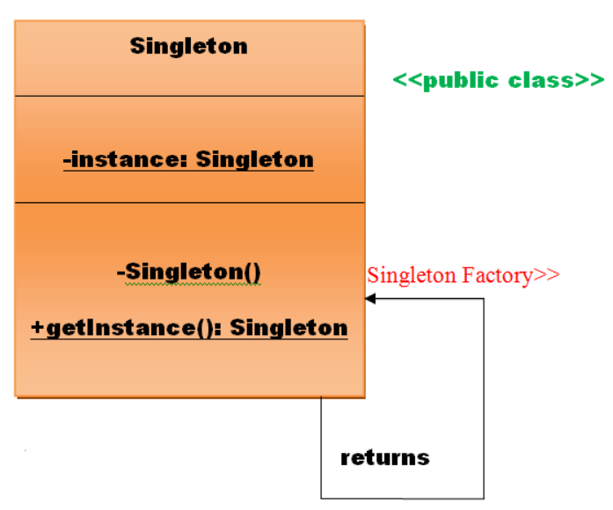
Singleton: Implementation
UML class diagram for the Singleton Pattern
Singleton pattern is used for logging, drivers objects, caching, and thread pool.
Singleton design pattern is also used in other design patterns like Abstract Factory, Builder, Prototype, Facade, etc.
Singleton design pattern is used in core Java classes also (for example, java.lang.Runtime, java.awt.Desktop).

Slide 17

Singleton: Implementation example
Problem Statement:
How can a shared office space with many employees, share the same printer. This makes sense, since it is often the reality for corporations and companies with employees sharing office facilities.

Slide 18
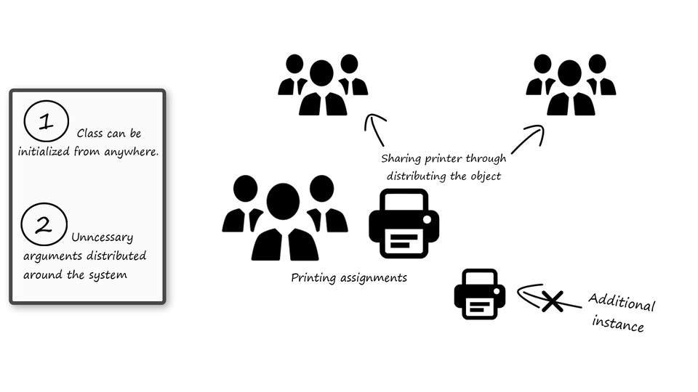
Singleton: Implementation example
Solution: Without singleton:
We simply have a system with two types of objects: The printer- and the employee object.
The employee object contains the information, which we want to print. In order to print we ask the employee object to print.
However, for the employee object to print, it needs an instance of a printer. We do not provide each employee with their own instance of the printer, since that would not simulate the real scenario.
Instead we provide the printer as an argument for when we want the employee to print. Thereby we can limit the number of printer object instances to one contained in the main context of the system.
public class Main {
public static void main(String[] args) {
Employee graham = new
Employee("Graham",
"CEO",
"Making excutive decisions");
Printer printer = new Printer();
graham.printCurrentAssignment(printer);
}
}
Notes:
This way of solving the problem is totally fine and will not at this scale present any problem. However, being able to initialize the class from anywhere and having unnecessary arguments for any method will at scale become a problem in terms of maintenance and understanding the code.
Since we know that there is only one printer in the office, the public constructor becomes a dangerous opportunity for the system. What if a developer sits in another part of the code and do not have the printer object available? Well they could just initialize it and use it.
However, this means that we suddenly have two printer objects in the code, which does not reflect the real-world scenario. This may cause problems if we for example wanted to keep track of all pages printed by the single instance of the printer.
Let’s imagine that we one day in the future add another method to the employee class, which also requires a printer. Say this method allows the employee to print multiple copies of a given document, with appropriate names and titles for each employee for which it is intended for.
As we can see the methods can quickly expand its list of arguments. Some of these arguments makes sense to provide for this method specifically, but the printer object is not one of them. Zero arguments are the optimal number of arguments.
We know that there is only one printer available at the office, so is it really necessary to provide it as an argument. Let’s see how we can solve this problem by utilizing the singleton pattern.
graham.printCopiesOfDocumentForListOfEmp(printer, 5, "Time schedule for the past five weeks" listOfEmployees);

Slide 19
Singleton: Implementation example
Solution: Without singleton:
5. This way of solving the problem is totally fine and will not at this scale present any problem. However, being able to initialize the class from anywhere and having unnecessary arguments for any method will at scale become a problem in terms of maintenance and understanding the code.
6. Since we know that there is only one printer in the office, the public constructor becomes a dangerous opportunity for the system. What if a developer sits in another part of the code and do not have the printer object available? Well they could just initialize it and use it.
7. However, this means that we suddenly have two printer objects in the code, which does not reflect the real-world scenario. This may cause problems if we for example wanted to keep track of all pages printed by the single instance of the printer.

Slide 20
Singleton: Implementation example
Solution: Without singleton:
8. Let’s imagine that we one day in the future add another method to the employee class, which also requires a printer. Say this method allows the employee to print multiple copies of a given document, with appropriate names and titles for each employee for which it is intended for.
9. As we can see the methods can quickly expand its list of arguments. Some of these arguments makes sense to provide for this method specifically, but the printer object is not one of them. Zero arguments are the optimal number of arguments.
10.We know that there is only one printer available at the office, so is it really necessary to provide it as an argument. Let’s see how we can solve this problem by utilizing the singleton pattern.
graham.printCopiesOfDocumentForListOfEmp(printer,
5,
"Time schedule for the past five weeks"
listOfEmployees);

Slide 21
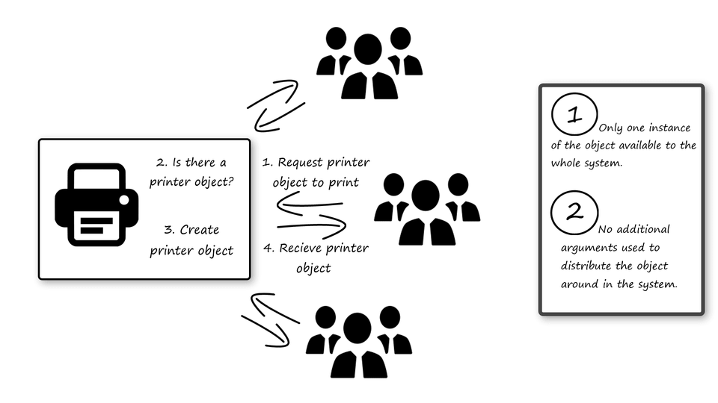
Design Solution
The concept of the singleton design pattern is based around a private constructor and a public static initialization method.
The private constructor ensures that the class can only be initialized by itself, which makes the public static initialization method the only way of getting an instance of the class.
Notes:
https://integu.net/singleton-pattern/
However, we do not want the method to start a new instance for each time it is call. Therefore, we save the instance of the class in a static field inside its own class
Now that we have an instance of the class ready to work with inside the class, we null check on it when we call the static initialization method. If the class has not previously been initialized, then we initialize it, otherwise we return our static field instance.
This means that there will always only be one instance of the class available, hence the singleton pattern.

Slide 22
Design Solution
However, we do not want the method to start a new instance for each time it is called. Therefore, we save the instance of the class in a static field inside its own class.
Now that we have an instance of the class ready to work with inside the class, we null check on it when we call the static initialization method. If the class has not previously been initialized, then we initialize it, otherwise we return our static field instance.
This means that there will always only be one instance of the class available, hence the name singleton pattern.
Notes:
https://integu.net/singleton-pattern/

Slide 23
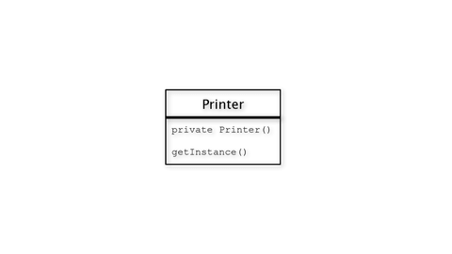
Class Diagram (UML)
In terms of class diagram, the singleton pattern is not worth talking about. As you might have figured out by now, the singleton pattern is based around two methods inside the same class, which makes the class diagram simple to understand.
Thereby said, that if you understand the concept of the singleton pattern from the previous section, you should be ready to dive into the code.
Notes:
https://integu.net/singleton-pattern/

Slide 24
Code (Java)
Printer
public class Printer {
private static Printer printer;
private int nrOfPages;
private Printer() {
}
public static Printer getInstance() {
return printer == null ?
printer = new Printer() :
printer;
}
public void print(String text){
System.out.println(text +
"n" + "Pages printed today " + ++nrOfPages +
"n" + "---------");
}
}
Employee
public class Employee {
private final String name;
private final String role;
private final String assignment;
public Employee(String name, String role, String assignment) {
this.name = name;
this.role = role;
this.assignment = assignment;
}
public void printCurrentAssignment(){
Printer printer = Printer.getInstance();
printer.print("Employee: " + name + "n" +
"Role: " + role + "n" +
"Assignment: " + assignment + "n");
}
}
Notes:
https://integu.net/singleton-pattern/

Slide 25
Code (Java)
How To Use The Singleton Pattern
public class Main {
public static void main(String[] args) {
Employee graham = new Employee("Graham", "CEO", "Making excutive decisions");
Employee sara = new Employee("Sara","Consultant", "Consuting the company");
Employee tim = new Employee("Tim","Salesmen", "Selling the company's products");
Employee emma = new Employee("Emma", "Developer", "Developing the latest mobile app.");
graham.printCurrentAssignment();
sara.printCurrentAssignment();
tim.printCurrentAssignment();
emma.printCurrentAssignment();
}
}
Notes:
https://integu.net/singleton-pattern/

Slide 26
Applicability
Use the Singleton pattern when
there must be exactly one instance of a class, and it must be accessible to clients from a well-known access point.
when the sole instance should be extensible by subclassing, and clients should be able to use an extended instance without modifying their code.
Notes:
Use the Singleton pattern when a class in your program should have just a single instance available to all clients; for example, a single database object shared by different parts of the program.
The Singleton pattern disables all other means of creating objects of a class except for the special creation method. This method either creates a new object or returns an existing one if it has already been created.
Use the Singleton pattern when you need stricter control over global variables.
Unlike global variables, the Singleton pattern guarantees that there’s just one instance of a class. Nothing, except for the Singleton class itself, can replace the cached instance.
Note that you can always adjust this limitation and allow creating any number of Singleton instances. The only piece of code that needs changing is the body of the getInstance method.

Slide 27
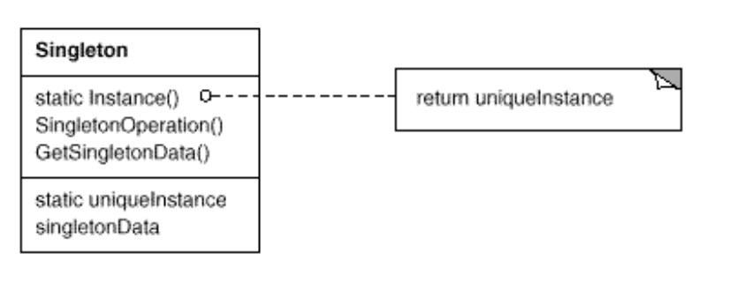
Structure

Slide 28
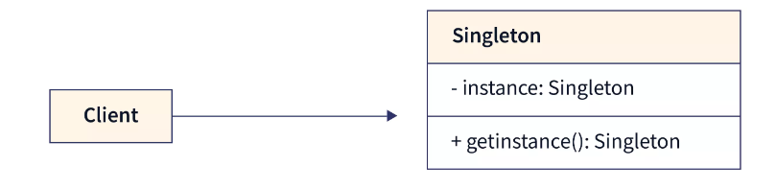
Participants
Singleton design pattern has two core participants: Singleton and Client.
defines an Instance operation that lets clients access its unique
instance. Instance is a class operation (that is, a class method and a static member function).
may be responsible for creating its own unique instance.
Notes:
There are many classes in Java Development Kit which is written using singleton pattern, some of which are as mentioned below:
lang. Runtime with getRuntime() method.
awt. Toolkit with getDefaultToolkit()
awt. Desktop with getDesktop()

Slide 29
Collaborations
Clients access a Singleton instance solely through Singleton's Instance operation.

Slide 30
Consequence
The Singleton pattern has several benefits:
Controlled access to sole instance. Because the Singleton class encapsulates its sole instance, it can have strict control over how and when clients access it.
Reduced name space. The Singleton pattern is an improvement over global variables. It avoids polluting the name space with global variables that store sole instances.
Permits refinement of operations and representation. The Singleton class may be subclassed, and it's easy to configure an application with an instance of this extended class. You can configure the application with an instance of the class you need at run-time.

Slide 31
Consequence
The Singleton pattern has several benefits:
4. Permits a variable number of instances. The pattern makes it easy to change your mind and allow more than one instance of the Singleton class. Moreover, you can use the same approach to control the number of instances that the application uses. Only the operation that grants access to the Singleton instance needs to change
5. More flexible than class operations. Another way to package a singleton's functionality is to use class operations (that is, static member functions or class methods). But both of these language techniques make it hard to change a design to allow more than one instance of a class. Moreover, static member functions in class are compile time, so subclasses can't override them polymorphically.

Slide 32
Implementation
Java Singleton Pattern Implementation
Add a private static field to the class for storing the singleton instance.
Declare a public static creation method for getting the singleton instance.
Implement “lazy initialization” inside the static method. It should create a new object on its first call and put it into the static field. The method should always return that instance on all subsequent calls.
Make the constructor of the class private. The static method of the class will still be able to call the constructor, but not the other objects.
Go over the client code and replace all direct calls to the singleton’s constructor with calls to its static creation method.

Slide 33
Implementation
various design options for implementing Singleton:
Method 1: lazy instantiation
Here we have declared getInstance() static so that we can call it without instantiating the class.
The first time getInstance() is called it creates a new singleton object and after that it just returns the same object.
Note that Singleton obj is not created until we need it and call getInstance() method. This is called lazy instantiation.
// Classical Java implementation of singleton design pattern
class Singleton
{
private static Singleton obj;
// private constructor to force use of
// getInstance() to create Singleton object
private Singleton() {}
public static Singleton getInstance()
{
if (obj==null)
obj = new Singleton();
return obj;
}
}

Slide 34
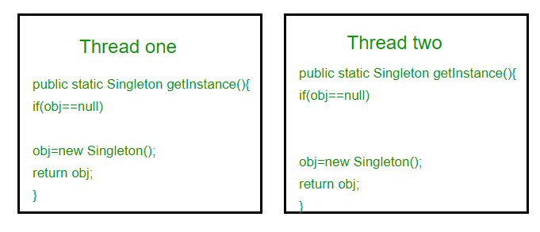
Implementation
The main problem with above method is that it is not thread safe. Consider the following execution sequence.
This execution sequence creates two objects for singleton. Therefore this classic implementation is not thread safe.

Slide 35
Implementation
Method 2: make getInstance() synchronized
Here using synchronized makes sure that only one thread at a time can execute getInstance().
The main disadvantage of this is method is that using synchronized every time while creating the singleton object is expensive and may decrease the performance of your program.
However if performance of getInstance() is not critical for your application this method provides a clean and simple solution.
// Thread Synchronized Java implementation of
// singleton design pattern
class Singleton
{
private static Singleton obj;
private Singleton() {}
// Only one thread can execute this at a time
public static synchronized Singleton getInstance()
{
if (obj==null)
obj = new Singleton();
return obj;
}
}

Slide 36
Implementation
Method 3: Eager Instantiation
Here we have created instance of singleton in static initializer.
JVM executes static initializer when the class is loaded and hence this is guaranteed to be thread safe.
Use this method only when your singleton class is light and is used throughout the execution of your program.
// Static initializer based Java implementation of
// singleton design pattern
class Singleton
{
private static Singleton obj = new Singleton();
private Singleton() {}
public static Singleton getInstance()
{
return obj;
}
}

Slide 37
Implementation
Method 4 (Best): Use “Double Checked Locking”
By considering method 2,once an object is created , the synchronization is no longer useful because obj will not be null and any sequence of operations will lead to consistent results.
So we will only acquire lock on the getInstance() once, when the obj is null.
This way we only synchronize just what we want.
// Double Checked Locking based Java implementation of
// singleton design pattern
class Singleton
{
private static volatile Singleton obj = null;
private Singleton() {}
public static Singleton getInstance()
{
if (obj == null)
{
// To make thread safe
synchronized (Singleton.class)
{
// check again as multiple threads
// can reach above step
if (obj==null)
obj = new Singleton();
}
}
return obj;
}
}

Slide 38
Implementation
We have declared the obj volatile which ensures that multiple threads offer the obj variable correctly when it is being initialized to Singleton instance.
This method drastically reduces the overhead of calling the synchronized method every time.
Notes:
Using volatile is yet another way (like synchronized, atomic wrapper) of making class thread-safe. Thread-safe means that a method or class instance can be used by multiple threads at the same time without any problem

Slide 39
Pros and Cons
PROS
You can be sure that a class has only a single instance.
You gain a global access point to that instance.
The singleton object is initialized only when it’s requested for the first time.
CONS
Violates the Single Responsibility Principle. The pattern solves two problems at the time.
The Singleton pattern can mask bad design, for instance, when the components of the program know too much about each other.
The pattern requires special treatment in a multithreaded environment so that multiple threads won’t create a singleton object several times.
It may be difficult to unit test the client code of the Singleton because many test frameworks rely on inheritance when producing mock objects.
Notes:
4. Since the constructor of the singleton class is private and overriding static methods is impossible in most languages, you will need to think of a creative way to mock the singleton. Or just don’t write the tests. Or don’t use the Singleton pattern.

Slide 40
Relations with Other Patterns
A Facade class can often be transformed into a Singleton since a single facade object is sufficient in most cases.
Flyweight would resemble Singleton if you somehow managed to reduce all shared states of the objects to just one flyweight object. But there are two fundamental differences between these patterns:
There should be only one Singleton instance, whereas a Flyweight class can have multiple instances with different intrinsic states.
The Singleton object can be mutable. Flyweight objects are immutable.
Abstract Factories, Builders and Prototypes can all be implemented as Singletons.
Facade objects are often Singletons because only one Facade object is required.
Notes:
The advantage of Singleton over global variables is that you are absolutely sure of the number of instances when you use Singleton, and, you can change your mind and manage any number of instances.
The Singleton design pattern is one of the most inappropriately used patterns. Singletons are intended to be used when a class must have exactly one instance, no more, no less. Designers frequently use Singletons in a misguided attempt to replace global variables. A Singleton is, for intents and purposes, a global variable. The Singleton does not do away with the global; it merely renames it.
When is Singleton unnecessary? Short answer: most of the time. Long answer: when it's simpler to pass an object resource as a reference to the objects that need it, rather than letting objects access the resource globally. The real problem with Singletons is that they give you such a good excuse not to think carefully about the appropriate visibility of an object. Finding the right balance of exposure and protection for an object is critical for maintaining flexibility.

Slide 41
Demo
Singleton Pattern_ Example. txt

Slide 42
References
Text Reference
Design Patterns: Elements of Reusable Object-Oriented Software, GOF
Web Reference
https://integu.net/singleton-pattern/
https://refactoring.guru/design-patterns/singleton
https://www.geeksforgeeks.org/singleton-design-pattern/
https://refactoring.guru/design-patterns/singleton/java/example
https://sourcemaking.com/design_patterns/singleton

Slide 43
THANK YOU
Prof Nivedita Kasturi
Department of Computer Science and Engineering
niveditak@pes.edu@pes.edu

